Slide 1
Ensemble Toolkit
http://radical-cybertools.github.com
http://radical.rutgers.edu

Slide 2
Ensemble Toolkit: Overview
Supports scalable execution of large ensembles of tasks
Simplifies application development and execution
  Provides components to compose the application
  Methods and strategies for application execution kept internal to the toolkit (relives user)
Provides “constrained flexibility” to compose ensemble-based “workflows”

Slide 3
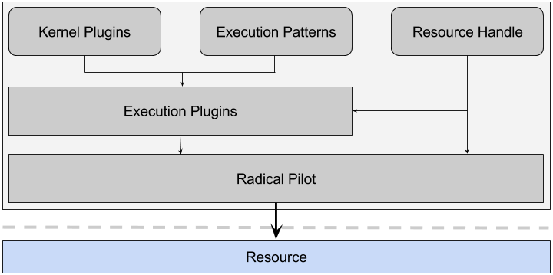
Ensemble Toolkit: System Perspective
Resource handle: Representation of the HPC system. Allows users to allocate, execute, deallocate resources.
Kernel plugins: Abstraction of a compute task. Contains details of the software environment on each resource.
Execution patterns: A high level object that represents an application’s control flow. A parameterized template
Execution plugins: Binds the kernel plugins and the execution patterns; translates the tasks into executable units for the specific resource specified in the resource handle.

Slide 4
Ensemble Toolkit: Role of the components
Component | Role (answers the question..) | Responsibility
Kernel plugins | What to execute ? | User
Execution pattern | When to execute (the kernel) ? | User
Resource handle | Where to execute ? | User
Execution plugin | How to (best) execute ? | EnTK internal
Application

Slide 5
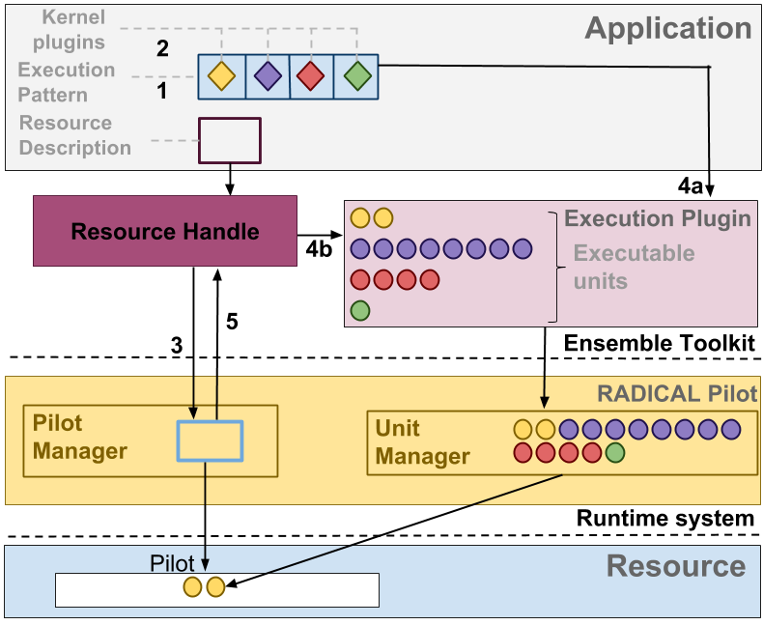
Ensemble Toolkit: User Perspective
Select required execution pattern. Create pattern object with required parameters
Select kernel plugins to fill the various stages of the execution pattern to create the workload
Create resource handle with resource details of the HPC system.
Allocate resources using the resource handle and “run” or “execute” the workload
Once execution is complete, run another workload or simply deallocate

Slide 6
Ensemble Toolkit: UI Sample
1 class MyApp(BagofTasks):
2
3 def __init__(self, stages,instances):
4 BagofTasks.__init__(self, stages,instances)
5
6 def stage_1(self, instance):
7 k = Kernel(name="misc.hello")
8 k.arguments = ["--file=output.txt"]
9 return k
10
11
12 app = MyApp(stages=1,instances=4)
13
14 cluster = SingleClusterEnvironment(
15 resource="xsede.stmpade",
16 cores=4,
17 walltime=15,
18 username=’vivek’,
19 project=’abc’)
20
21 cluster.run(app)
Execution pattern
Kernel plugin
Resource handle
Execute workload on the resource

Slide 7
Ensemble Toolkit: Documentation
User guide: http://radicalensemblemd.readthedocs.org/en/latest/
Repository: https://github.com/radical-cybertools/radical.ensemblemd
Technical paper: http://arxiv.org/abs/1602.00678

